Slide 1
Document Management
Human Resources
Scanning/Laserfische
Credentials
Technology
Sub-Finder
CODESP
Accounting
GASB45/Revenue Limit/Mandated Costs
Disaster Recovery
Benefits Management
SharePoint
QSS
Position Control-Payroll-Budget
Fiber Networks- Connecting your Schools
School
Business
State of the Governors Budget
Optimizing Your Lab Infrastructure
QCC
Finance - Grant /Pupil Accounting
Payroll
Risk Management
Preventing School Arson
Retirement
STRS/PERS
Purchasing- PO Routing
Absence Tracking
Office 2007
Fixed Assets
QCC
Excel
Word
QSS
Integrated Resources Seminar
QCC Absence Tracking

Slide 2
Presenter Information
Name: Allen Tang
Title: Application Support Analyst
Email: allen_tang@sccoe.org
Phone: (408) 453-6748 (Help Desk)
Notes:
Talk about Help Desk
Provide address if they promise to send money.

Slide 3
Goal of this Seminar
Introduce a new method of managing employee’s absences in QSS
Discuss the benefits of an integrated Absence Tracking System
Discuss Absence Tracking Terminology
Discuss implementation steps
Demonstrate search & reporting capabilities
Notes:
Districts use many different methods: Cards, homegrown databases, spreadsheets
Today: present an approach that will allow you to integrate this process with QSS.
Absence Tracking is its own module
Exists on its own function link in QCC (so you can set security accordingly)

Slide 4
Benefits
Integration!
Reports, Report, Reports!
  By Absence Reason
  By employee
  By work location
  Pattern of leave taken
  Dollar amount of liability of unused leave
Ease of Use
Notes:
Putting the pieces together…. Perhaps, this is a piece of the puzzle that you were missing.
Reports
One central location where absences are managed
Ease of Use - One screen allows you to see all the absence information for an employee.

Slide 5
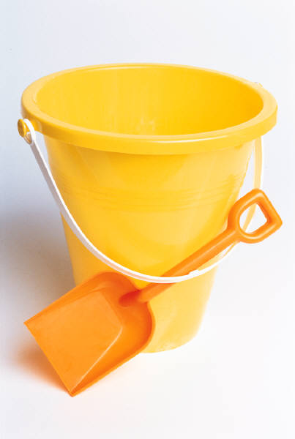
Absence Tracking
Concept
It is simply an accounting system!
Notes:
Demonstrate -
Depending on your district’s policies—the employees get a certain about of SICK LEAVE, VACATION LEAVE, and PERSONAL NECESSITY
When an employee accrues leave, the buckets get filled. (Accrual Rules)
When the employee takes time off, leave is deducted or added to the leave totals.

Slide 6
Absence Tracking
Terminology
Absence Reason
  Categories of leave you wish to track
Leave Group
  Group of employees that accrue leave at the same time based on longevity
  Includes leave buckets
Notes:
AR: Jury Duty, Personal Necessity, Vacation
LG: Buckets = running totals

Slide 7
Absence Tracking
Terminology (Cont’d)
Accrual Rules
  When leave is accrued
  How much leave is accrued
Absence Indices
  Rules for how each absence reason affects the buckets
Notes:
AC = Accrual Rules - set up to determine when leave is accrued, annually, monthly and how much leave is accrued for each accrual period.
AI = Absence Indices - determine how each reason affects the buckets. PN takes from both SL and PN. SL can borrow from VA, etc.

Slide 8
Basic Architecture
Leave
Group
Assigned to
Absence Reasons
Example: 12 Month Classified
Absence Indices
(Calculation Rules)
Accrual Rules
(When & how much)
Happy Employee
Vacation
Sick Leave
Notes:
Man who gets job -- so he is a happy employee.
He gets assigned to a Leave Group (Group of people who abide by the same absence rules based on their years of service)
Explain buckets and other stuff.
Implementing ABT may seem like a big undertaking, but it can be broken down into 3 basic steps.
(…and system will be able to accurately manage…)
Now, let’s look at each step more closely.

Slide 9
Step 1: Review Contract
Understand district rules and policies
Identify groups of employees that accrue leave by the same absence rules
Determine what types of absences your district wants to track
Notes:
Business practices
Bargaining Unit
Buckets

Slide 10
Step 2: Define Master Files
Absence Reasons (AR)
Leave Group (LG)
Absence Indices (AI)
Roll Codes (RO)
Accrual Rules (AC)
Notes:
Biggest challenge is translating district Absence policies and practices into QSS Tables

Slide 11
Step 3: Assign Employees
Use Employee Maintenance screen
  Leave screen (LV)
Enter employees balances
  (One time only)
Notes:
After the master files are created, entry of absences is done in one screen for employees. From this screen you enter the leave group and the absence transactions. The initial load of information loads in the employee balances. You only need to do this once, then it is tracked by the system.

Slide 12
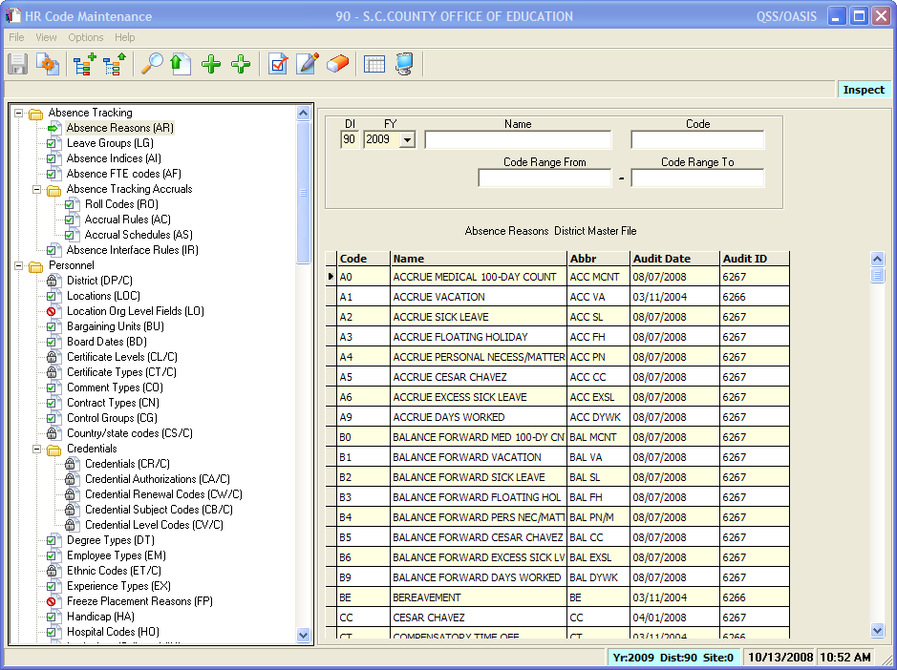
Absence Reasons
Notes:
This is the Absence Reason master file. This file contains all the absence reasons needed for your district. Everything from sick leave and vacation to jury duty. You can keep track of reasons that do not affect a bucket.

Slide 13
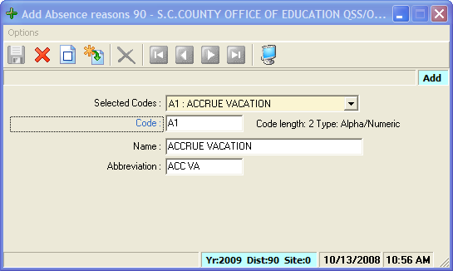
Absence Reasons Add with Pre-Load
Notes:
The Absence Reason screen allows you to copy from another reason with the Pre-Load option or…

Slide 14
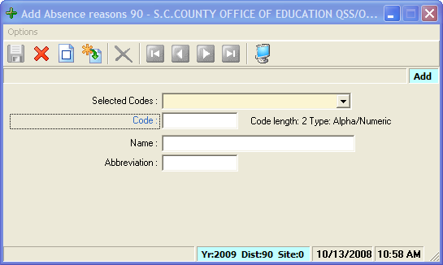
Absence Reasons Add without Pre-Load
Notes:
Start from scratch on a brand new reason.

Slide 15
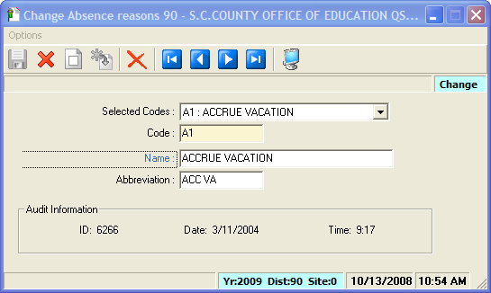
Absence Reasons
Change Screen
Notes:
This is the Absence Reasons change screen. From here you can make changes to the absence reason after you’ve added it.

Slide 16
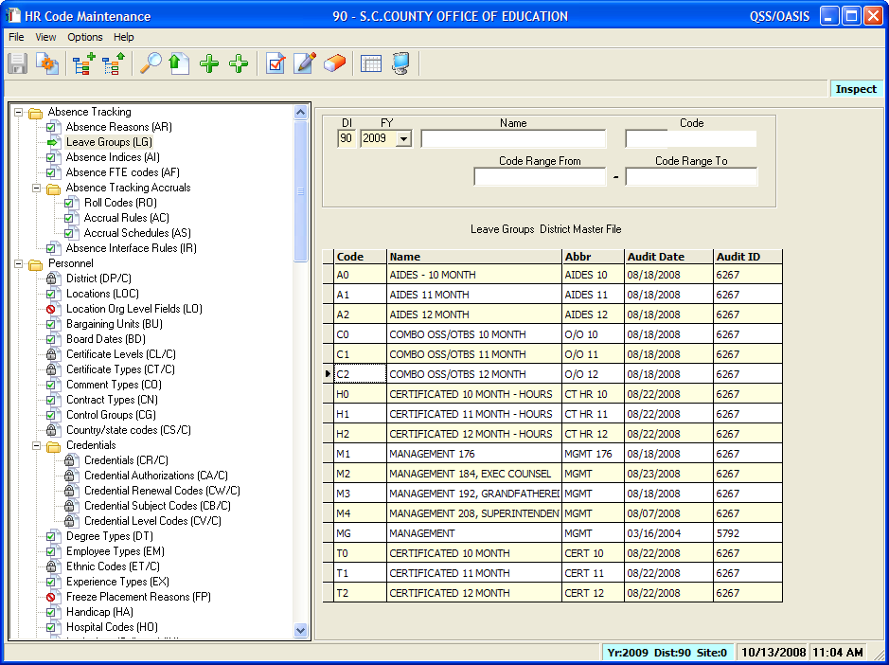
Leave Groups
Notes:
This is the Leave Group master file. Each leave group is treated the same as far as the kind of leave accrued and when and how much is accrued.

Slide 17
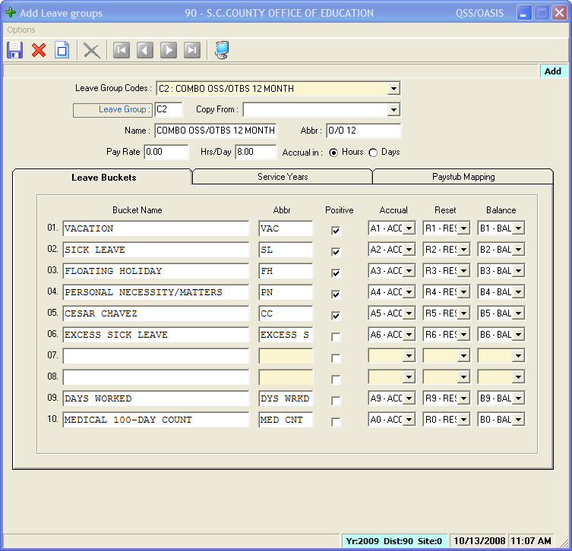
Leave Group Add Screen
Notes:
The Leave Group Add screen allows you to enter each leave bucket with the appropriate type of leave. Buckets one and two are used for Vacation and Sick leave, the rest is up to your district. In this screen the buckets are defined and the rules for Accrual Resetting and Balance forward are defined.

Slide 18
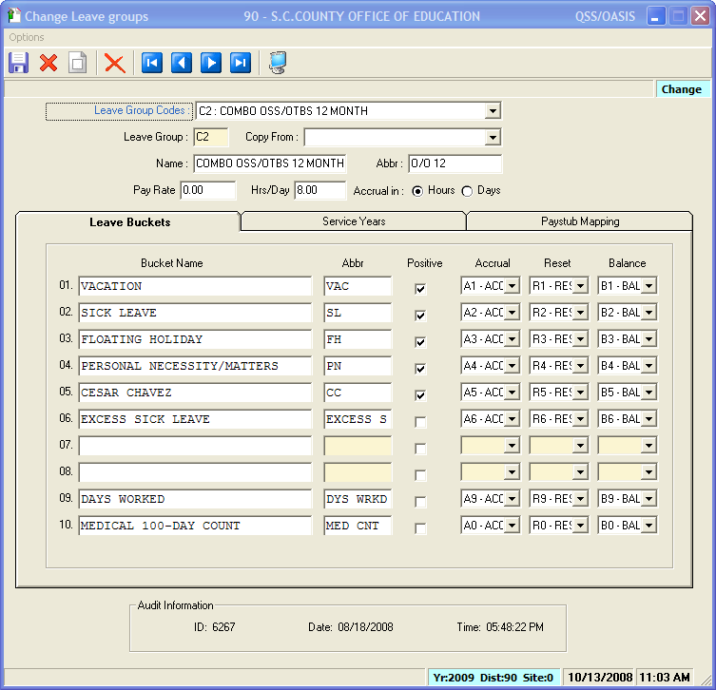
Leave Group
Change Screen
Notes:
The Leave Group Change screen allows you to make necessary changes to the Leave Groups. This should be done before implementing Absence Tracking. After that a new Leave group should be created if you need to make changes to an existing Leave Group to preserve history.

Slide 19
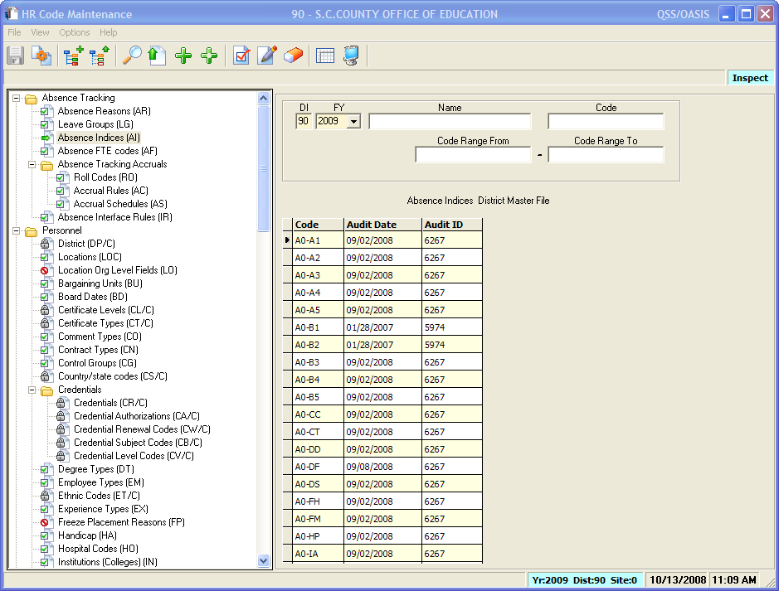
Absence Indices
Notes:
The Absence Indices determine rules applied to the leave group and the absence reasons.

Slide 20
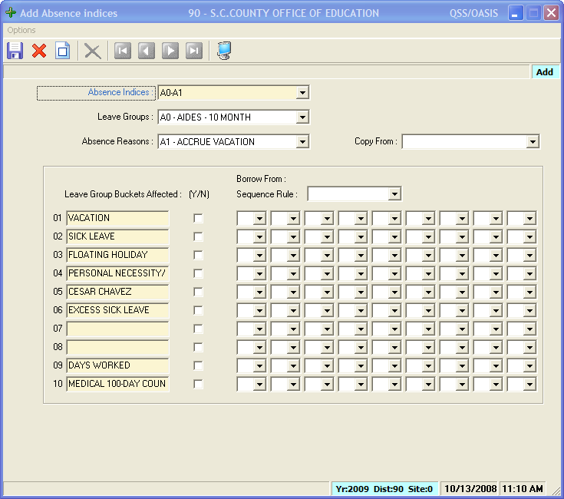
Absence Indices Add Screen
Notes:
The Absence Indices Add Screen allows you to affect certain buckets for each reason code.
For instance An Accrue Vacation would affect the Vacation bucket. The Personnel Necessity Absence Index would affect the Sick Leave and Personnel Necessity buckets.

Slide 21
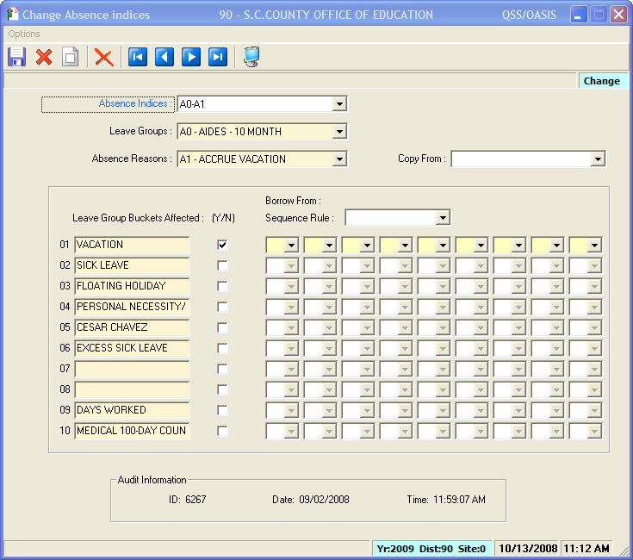
Absence Indices
Change Screen
Notes:
Changes are generally done before implementation. After that you might want to create new indices to protect the history.

Slide 22
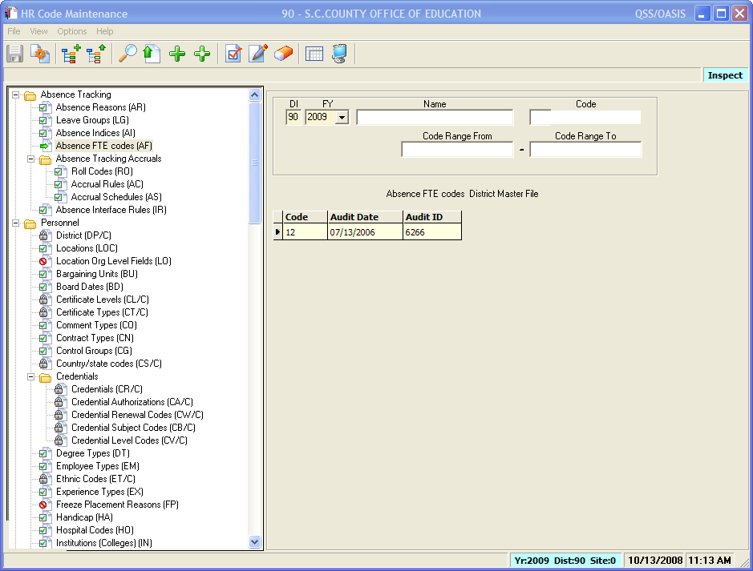
Absence FTE Codes
Notes:
The Absence FTE Codes allow you to give different accrual rates depending on FTE.

Slide 23
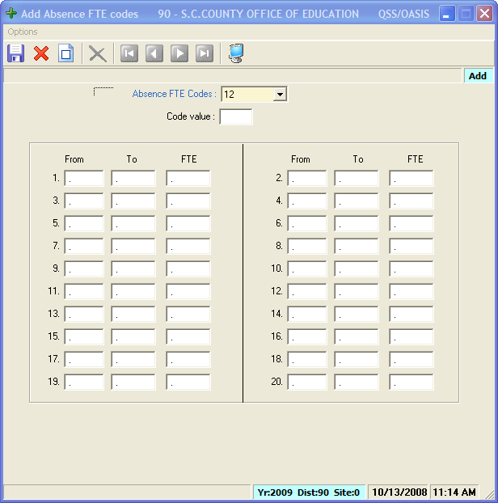
Absence FTE Code
Add Screen
Notes:
Here you can see how you can give ranges of FTE a certain FTE value.
This master file is used when you want to group FTE ranges rather than calculate based on actual FTE.

Slide 24
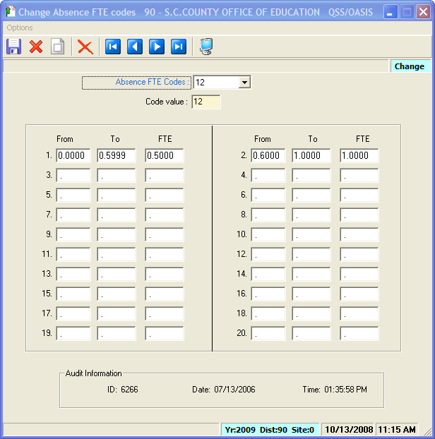
Absence FTE Code Change Screen
Notes:
Changes are made before implementation. Again you want to save the codes after implementation to protect history

Slide 25
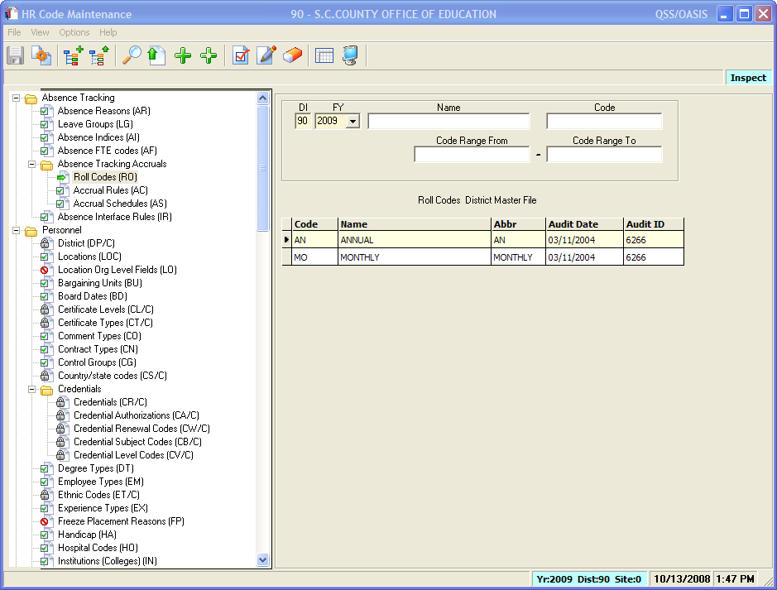
Roll Codes
Notes:
This master file tells the system when to do an accrual. Usually it’s annually or monthly.

Slide 26
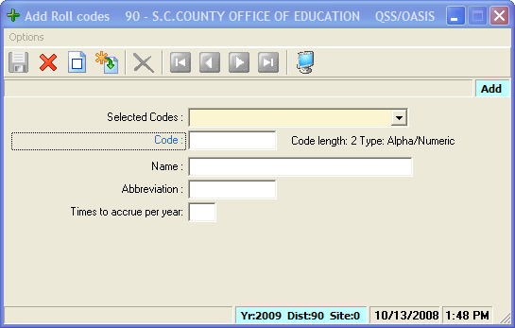
Roll Codes Add without Pre-Load
Notes:
The Roll Codes Add screen offers the option to add a brand new rule or…

Slide 27
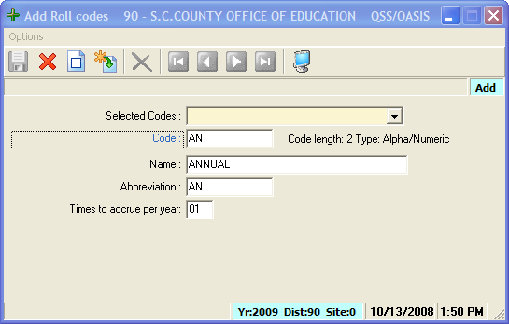
Roll Codes Add with Pre-Load
Notes:
Copy from another rule with the pre-load option.

Slide 28
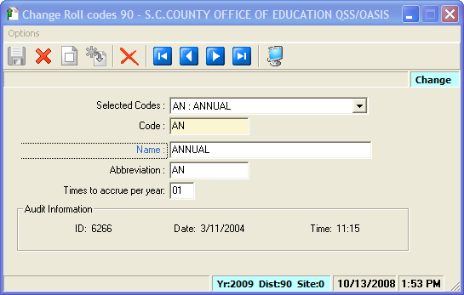
Roll Codes Change Screen
Notes:
Change options

Slide 29
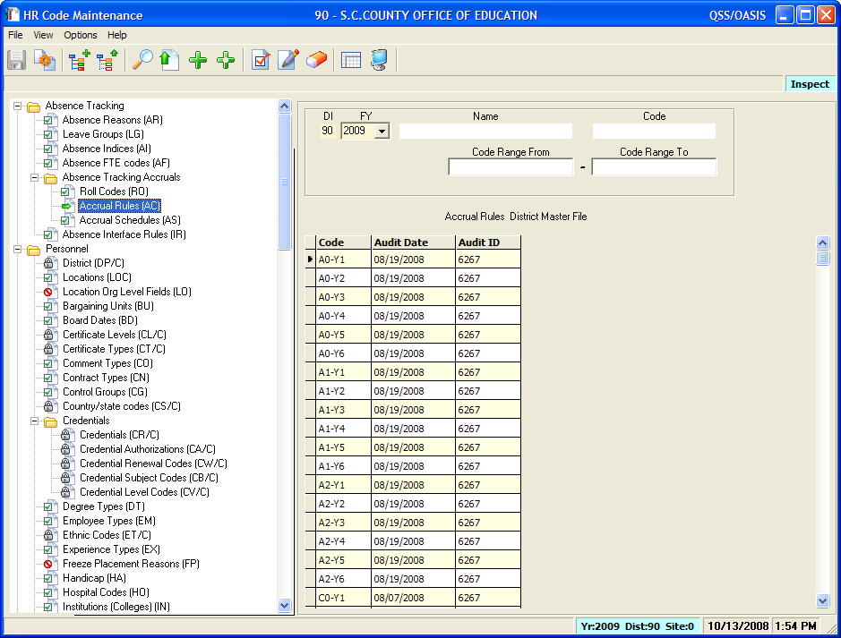
Accrual Rules
Notes:
Accrual rules. These rules are set up for each longevity tier, i.e., Y1, Y2, etc. and for each leave group.

Slide 30
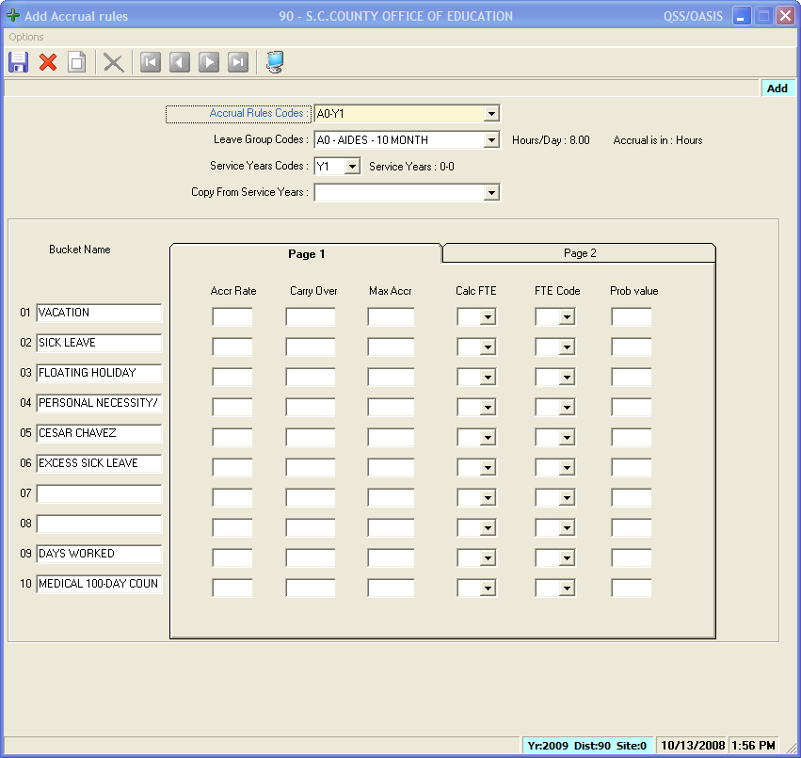
Accrual Rules Add Screen
Notes:
In the add screen you define which buckets are affected and how much gets accrued. You can set a maximum accrual You can use FTE for calculation or use the FTE Code for ranges. You can also give a probationary value.

Slide 31
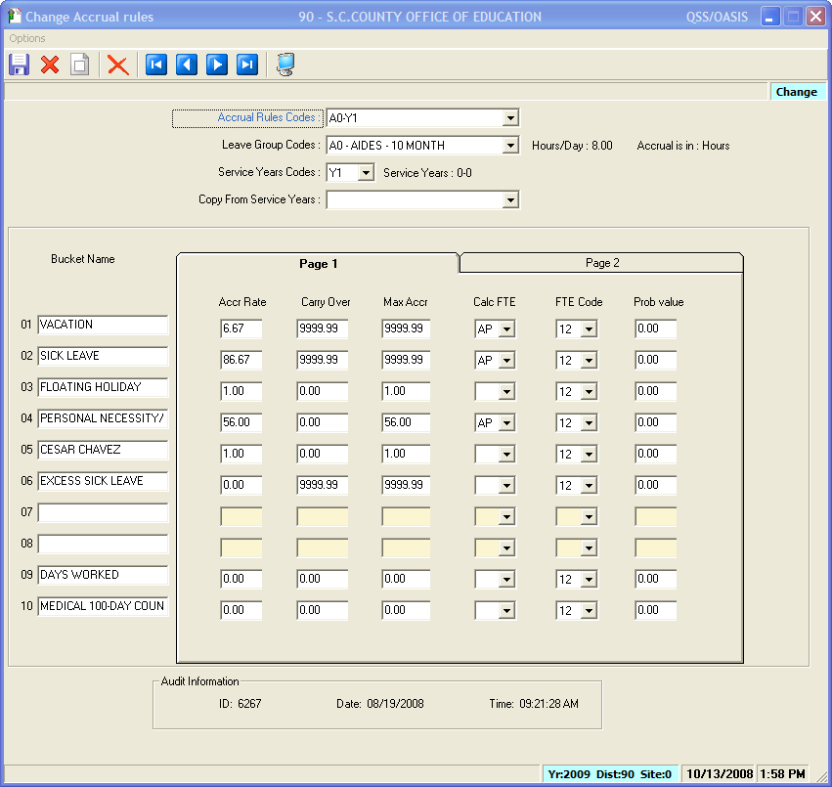
Accrual Rules
Change Screen

Slide 32
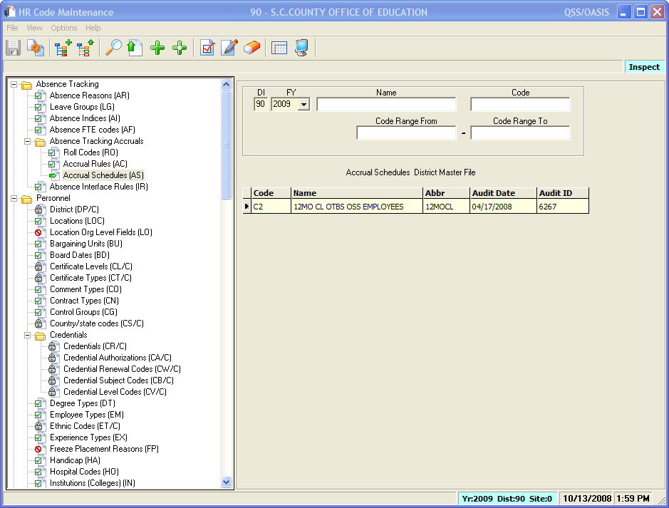
Accrual Schedules
Notes:
Accrual Schedules allow you to group accruals together for a group of people. You can assign up to 20 leave groups to one Accrual Schedule. This can streamline your accrual processing if you have multiple leave groups that accrue at the same rate and time periods.

Slide 33
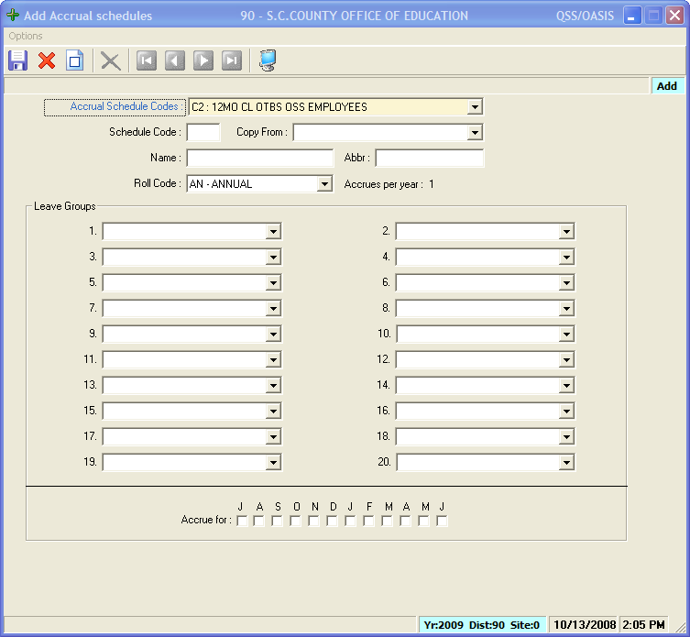
Accrual Schedules
Add Screen

Slide 34
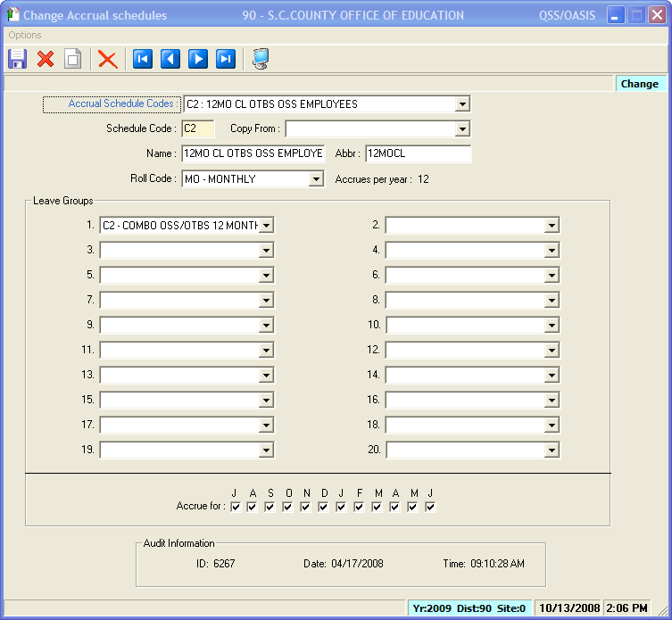
Accrual Schedules
Change Screen

Slide 35
Viewing the Whole Picture
Notes:
Any questions about master files before we go on to the main Absence Tracking screen?

Slide 36
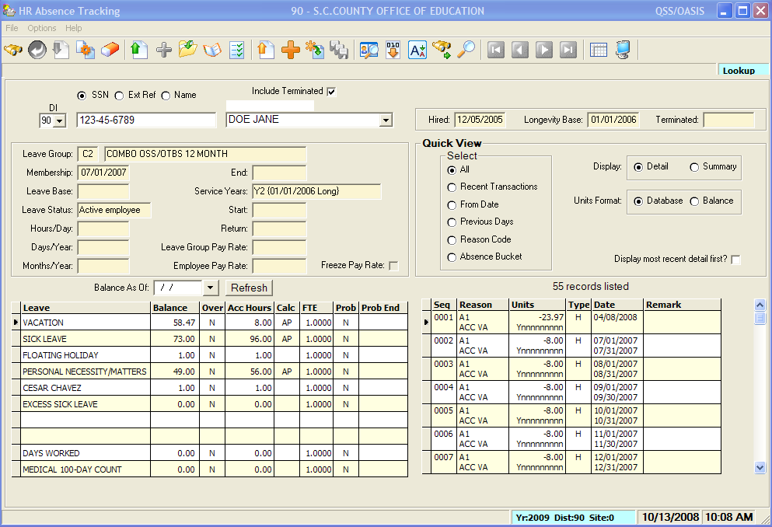
QCC Absence Tracking Screen
Notes:
You can access the Absence Tracking screen by SSN, Ext. Ret. # or Name.
On the main screen you have access to the balance information, the leave transactions and you can look at a summary view or detail view.
You have options to look at a snapshot of balances as of a specific date. And you can gridify each area into Excel.

Slide 37
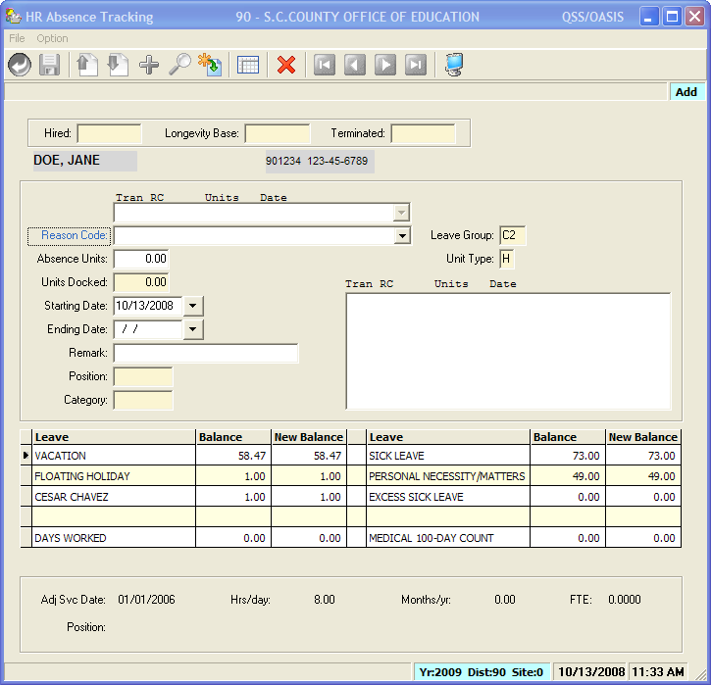
Absence Tracking
Add Screen
Notes:
This screen allows you to add an individual absence transaction for a person.

Slide 38
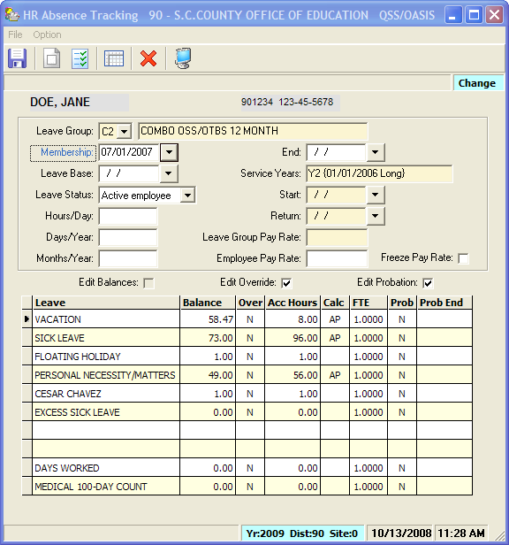
Absence Tracking
Change Screen
Notes:
The Change screen allows you to make changes. This should be done for correctional purposes mainly.

Slide 39
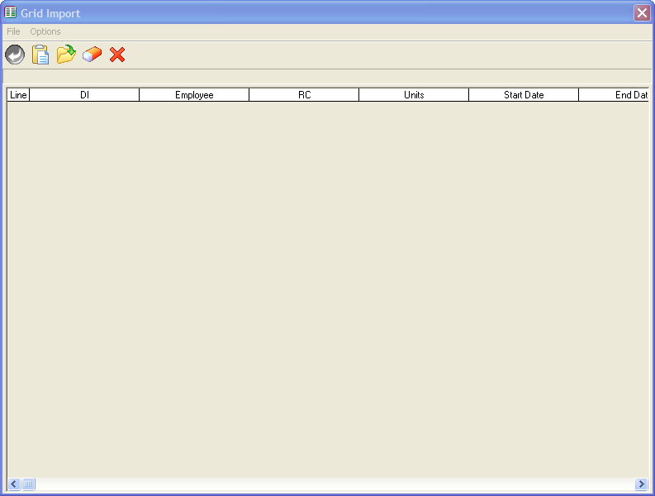
Import Screen
Notes:
You can import information from say a time keeping system.

Slide 40
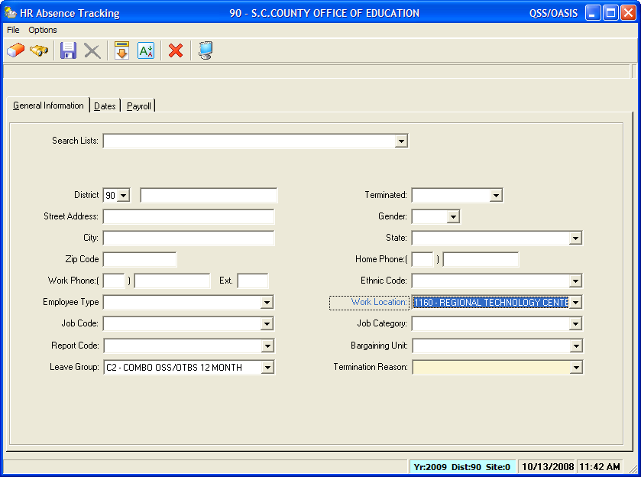
Advanced Search
Notes:
You have the ability to do an advanced search to find a group of people you want to process at one time.

Slide 41
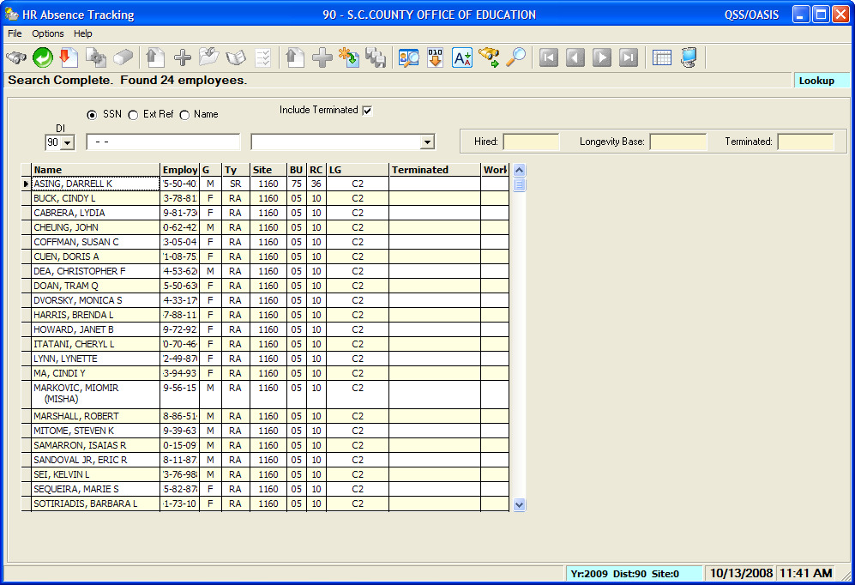
Advanced Search Results
Double-click to bring up Absence Tracking window
Notes:
After you launch the search and get the list of employees, you double-click on the employee to bring up the absence tracking window.

Slide 42
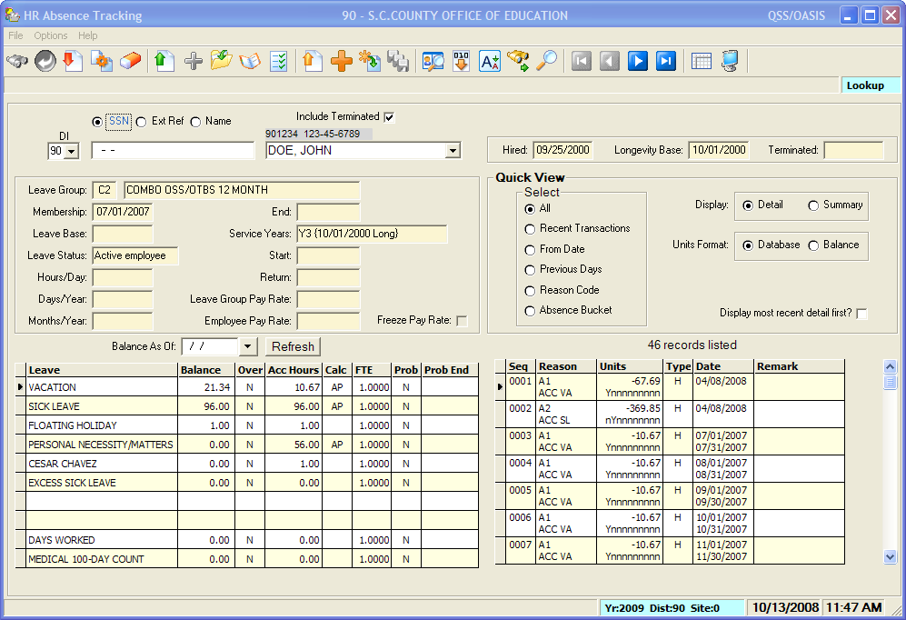
Processing Search List
Notes:
Then once you are in the main screen, you can use the video buttons to go through the search list person by person.

Slide 43
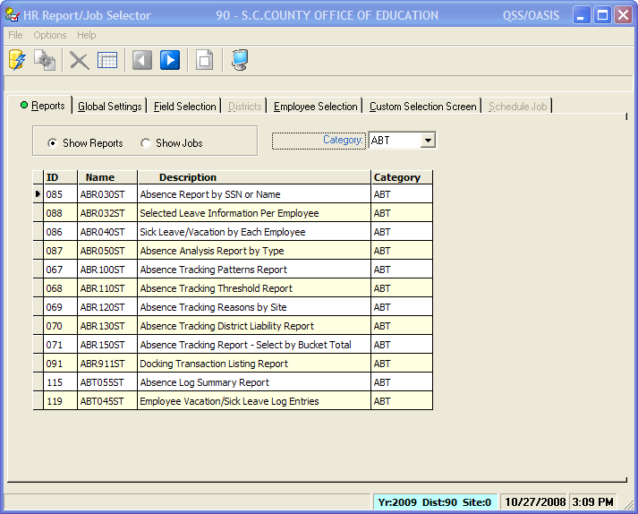
Reports

Slide 44
Summary
Implementing Absence Tracking will:
  Help your district integrate their systems
  Allow your district to produce valuable reports
It only takes 3 steps!
Notes:
We’ve covered the basic areas of the Absence Tracking module.
Implementing Absence tracking will help your district integrate their systems and allow for valuable reporting.
And set only takes 3 steps!

Slide 45

Questions?

Slide 46

Let’s put the pieces together!
Thank you for attending!

